Slide 1

autrui.
TEAM 10
Mihir Jham
Rishabh Mittal
Karan Kalwani
Manmohit Sehgal
Ankit Kapur

Slide 2
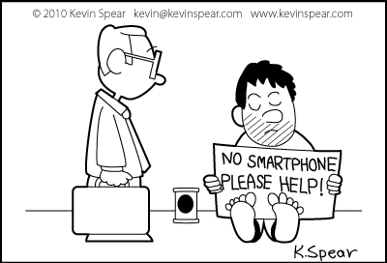
Problem Motivation
With the advent of technology in the daily lives of people in the past decade, it has been through many forms of uses – from being a luxury to utility to now a means of entertainment.
We see that though this transition has bought greater connectivity and access to information, it has also lost compassion somewhere down the road. The whole world of the social network seems cold and lacks benevolence.
Hence we thought of “autrui.”

Slide 3
Project Goals
Create an environment where people could share their deeds.
Create a social network where people can connect each other via these deeds.
Users should be able to view the global impact of their deeds.

Slide 4
Design Outline
# | Design Requirements | Choices | Decisions
1. | Platform and user interface implementation | iOS 7.0.4 or Android 4.4 | Android 4.4
2. | Server hosting and management | Heroku or Parse | Parse
3. | Social integration | Facebook or Twitter | Facebook
4. | Database hosting | PostgreSQL or MongoDB or Parse | Parse

Slide 5
Demo

Slide 6
Bibliography
Slide 2 – Picture: Spear, K. (2010, January 16). kevinspear.com. Technology Cartoons. Retrieved April 23, 2014, from http://kevinspear.com/tag/technology-cartoons

